Slide 1
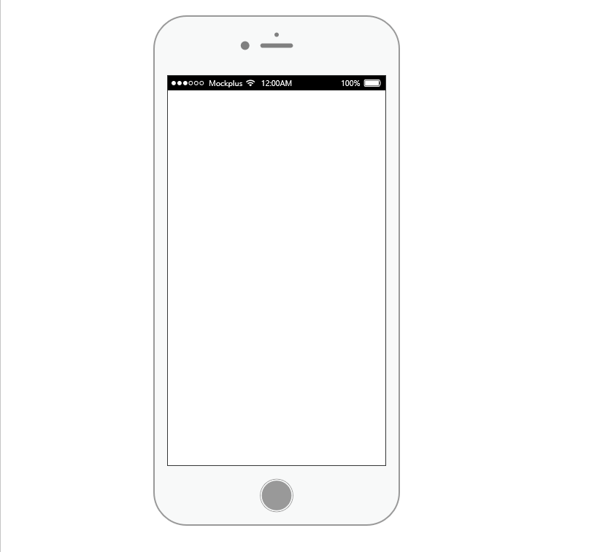

Registration
Name:
Profession:
Email ID:
Password:
Confirm Password:
Already Have an Account?
Login Here
Login
Email ID:
Password
Login
Register
Notes:
The Registration from will need all these credentials and if you are already signed in you can just login

Slide 2

Progress
Progress
Calendar
Helping Children
Notes:
The Home Screen will have the buttons needed to go to other pages
The progress report will have how much money you earned that day.
The arrows will take you back to the home screen
The arrow on the home screen will take you back to the login and sign up screen

Slide 3
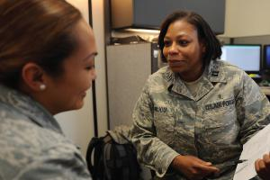
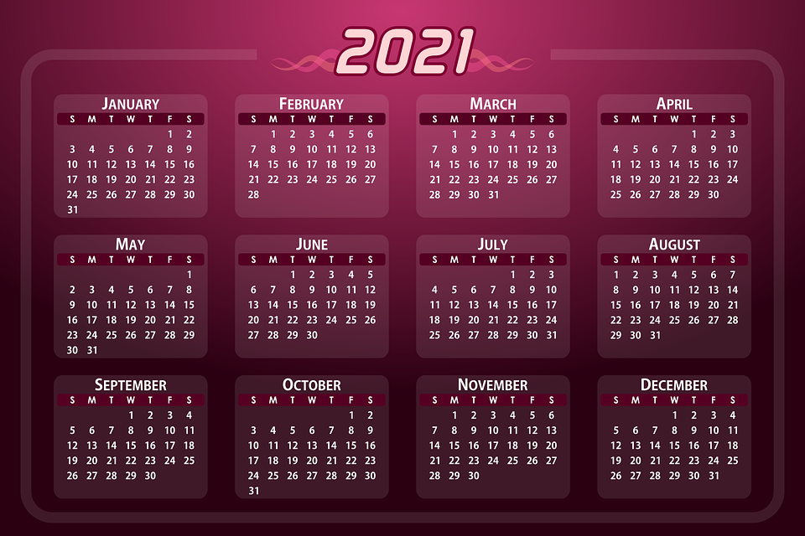
Calendar
Helping Children
Notes:
The calendar will mark all the meetings other things she has that are related to her job.
The Helping Children screen will show who she is going to work with next and basic details about them
The arrows will take you back to the home screen

